Slide 1


Slide 2

Learning Outcomes
To Comprehend Meaning and Significance of cash flow Statement.
To Examine, how the statement of cash flows is constructed as per IND-AS 7.
To Learn, how to read a cash flow statement and understand how a company makes and spends cash.

Slide 3
Can you think of ignoring an accrual principle???
No!!!!!!!!!!!!!
of course you are right
But:
There is an Exception.

Slide 4
Basis for preparation of financial Statements
Accrual Basis of Preparation
Balance Sheet
Income Statement
Cash Basis
Cash Flow Statement

Slide 5


Lets understand with help of an example
Let’s imagine you started a bakery business with $1,000.
You spent $1,000 on the cakes and sold them for $5,000 on one month credit.
Let’s determine your cash position in this scenario.
Revenue(sales): $5,000
Profit(Revenue-Expenses): $4,000
Cash: ZERO!
Notes:
Note:
Under accounting rules revenue is recognized when it is earned, not when it is received. Therefore, since you have made the sale to your customer, the sale must be recognized as revenue received.
You spent $1,000 on the cakes and sold them for $5,000. This leaves you with a profit of $4,000.

Slide 6

If you want to avoid bankruptcy: Monitor your Cash Flows
No Cash, possible to be profitable on papers but insolvent same time

Slide 7
Misconception:
If your books are showing you are highly profitable, then there is nothing to worry about.
Fact:
You do not use profits to pay for business operations. You need cash
.

Slide 8


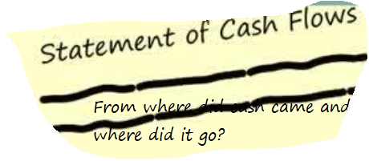
The crux of any business is profits well depicted by cash in the company
Cash flow statement
Ind-AS 7
“Where Got Where Gone Statement”.
Balance sheets and Income statements are only fiction
Cash flow is Reality

Slide 9
Statement of cash flows as an integral part of financial statements, mandatorily for all entities.
https://www.ril.com/getattachment/299caec5-2e8a-43b7-8f70-d633a150d07e/AnnualReport_2019-20.aspx

Slide 10
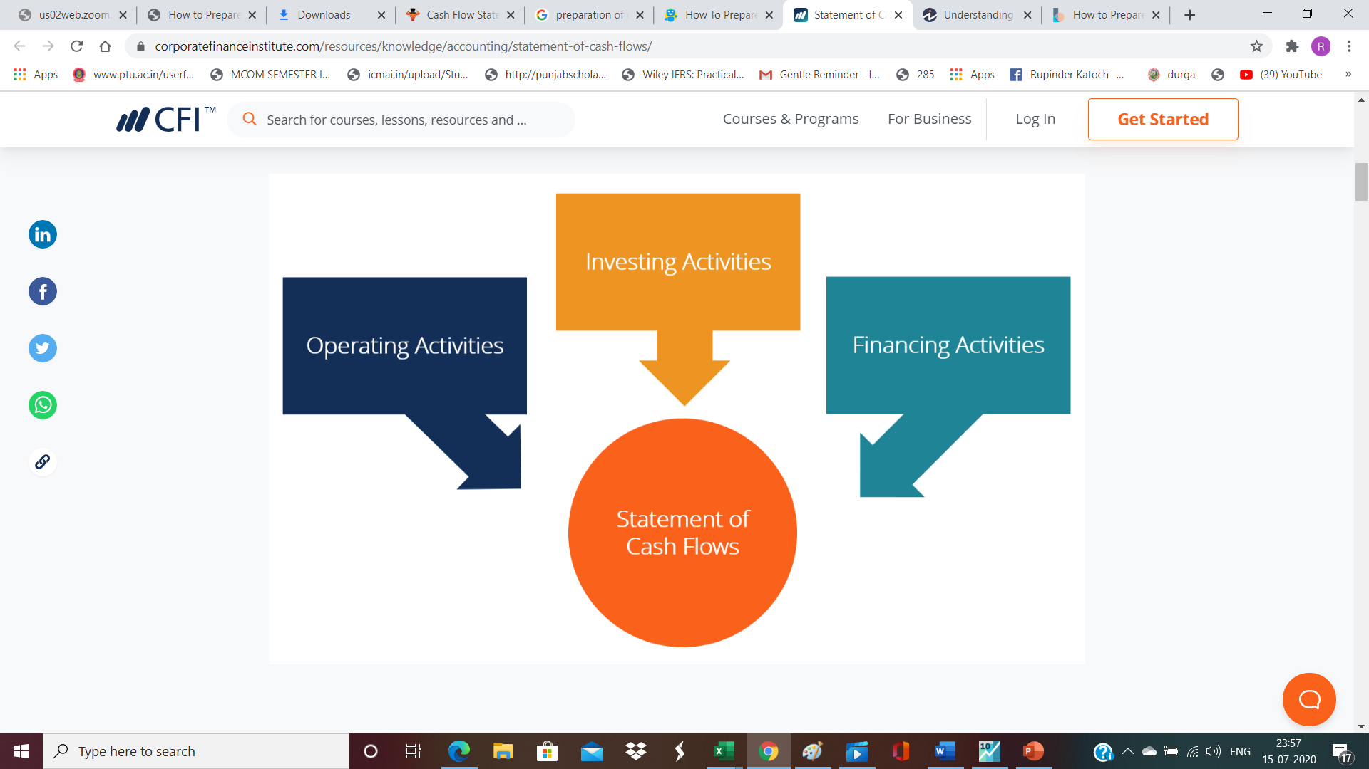
What is a Cash Flow Statement?
Notes:
This statement reports cash inflows and outflows based on the firm’s operating , investing and financing activities.

Slide 11
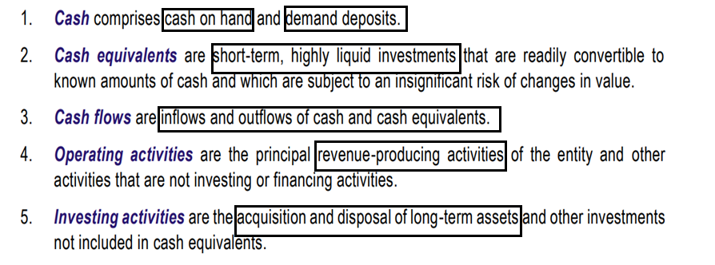
IND-AS 7:Important Definitions

Slide 12
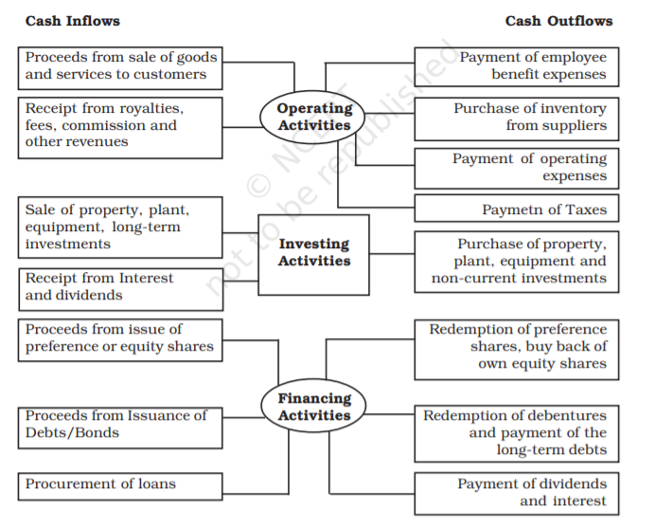

Slide 13
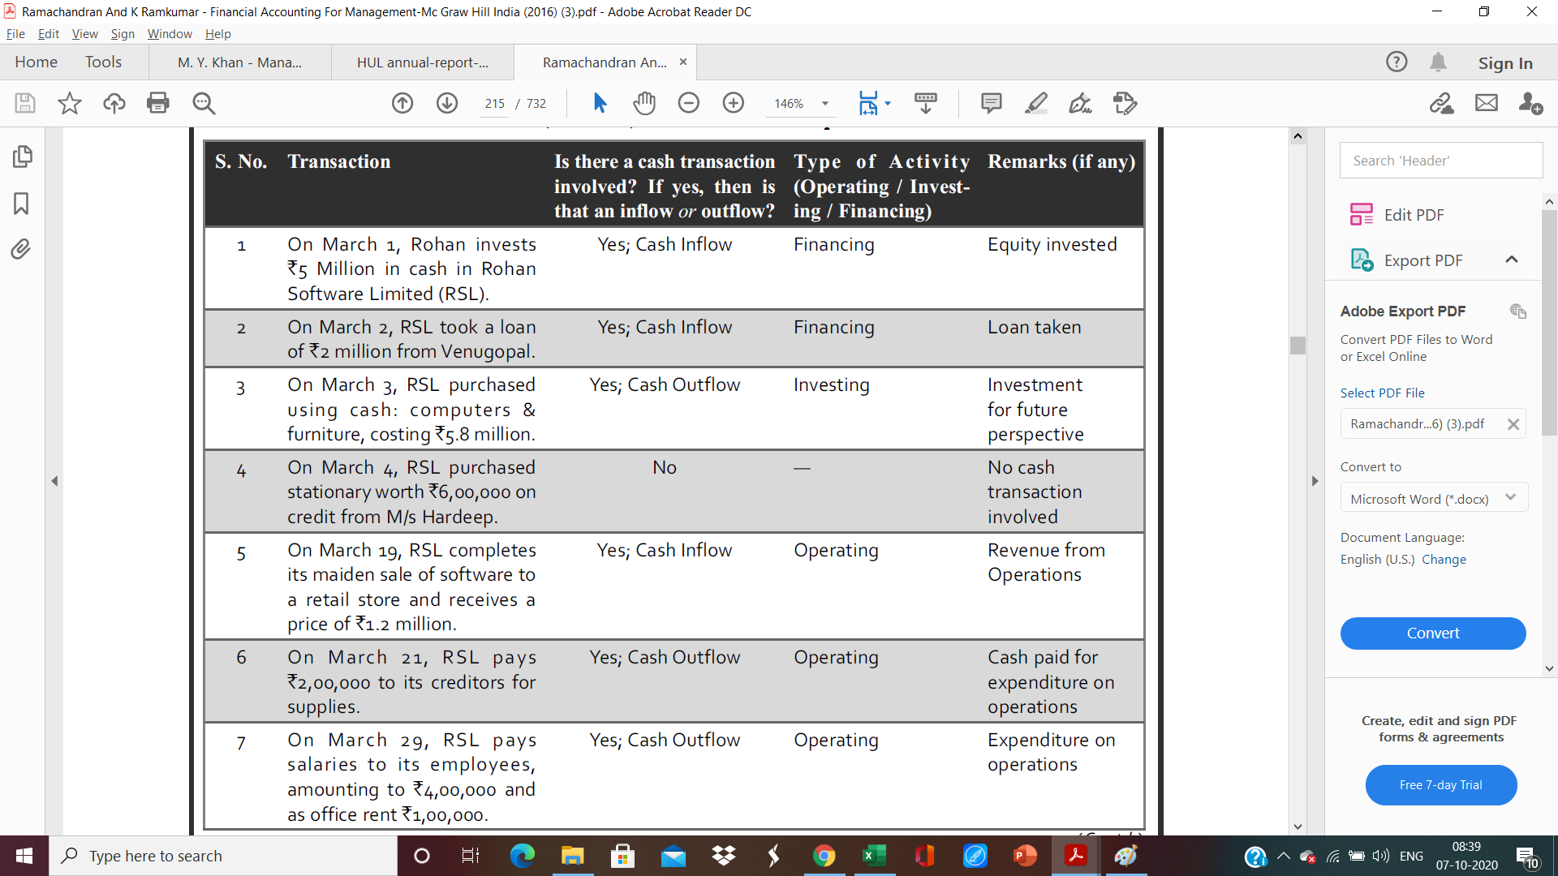

Slide 14
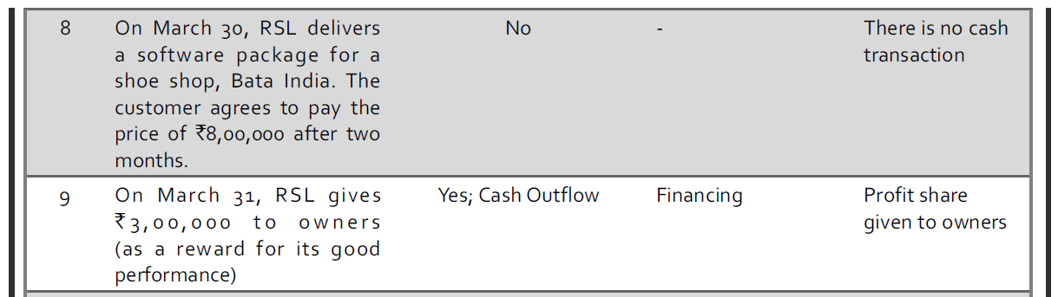

Slide 15
MCQ
Q. Choose the investing activity from Cash flows?
A) Issue of Debenture
B) Repayment of Long-term Loan
C) Purchase of Raw Materials for Cash
D) Sale of Investment by Non-Financial Enterprise
Notes:
D

Slide 16
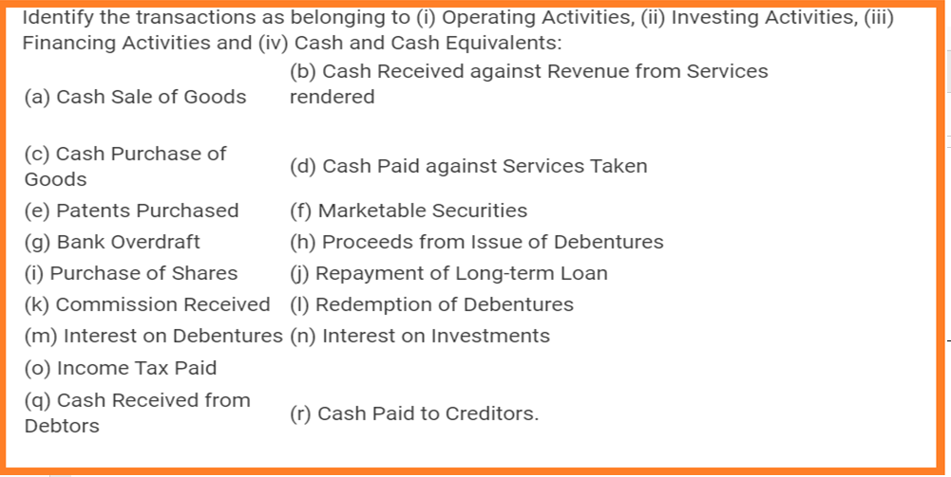
Question

Slide 17
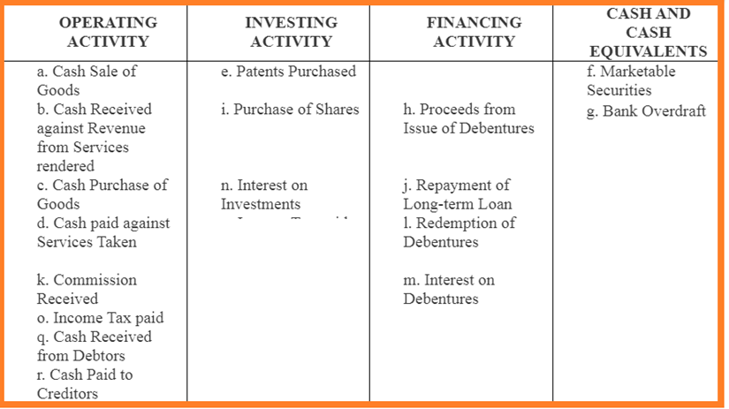
ANSWER

Slide 18
Drafting of Cash Flow Statement
Step I
Put Each Change in B/S to the Statement of Cash Flows
Step 2: Make Adjustments for Non-cash & Non operating Items from Income Statement
Step 3: Analysis and interpretation of cash-flow statement

Slide 19
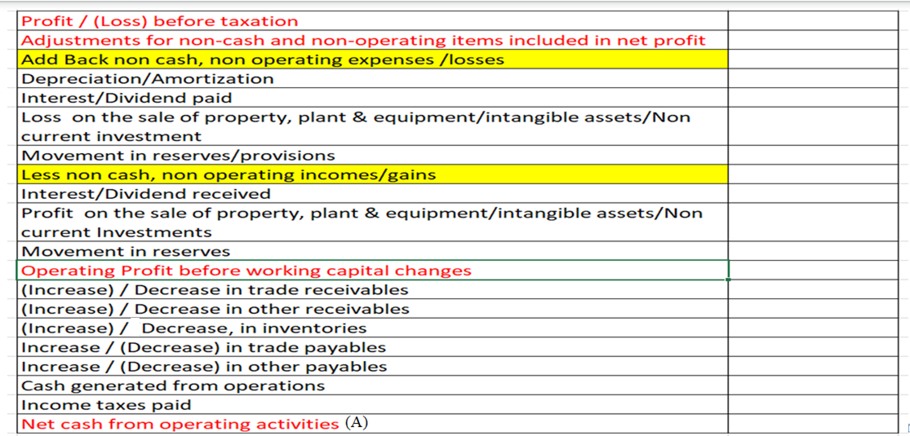
(A)Cash flows from operations (Indirect Method)

Slide 20
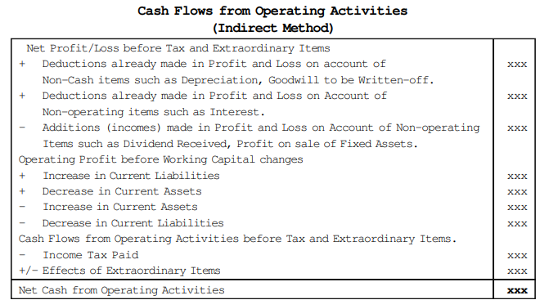

Slide 21
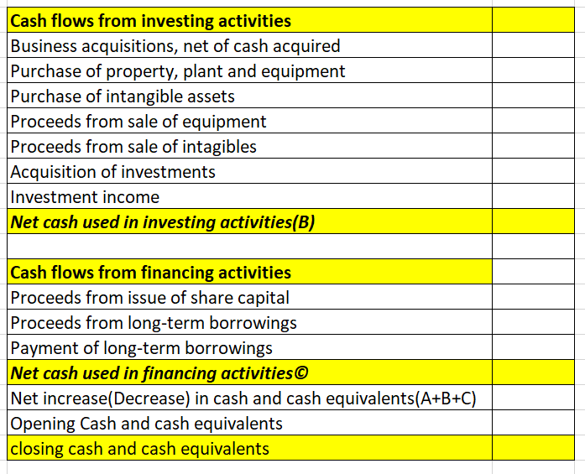
B and C part

Slide 22
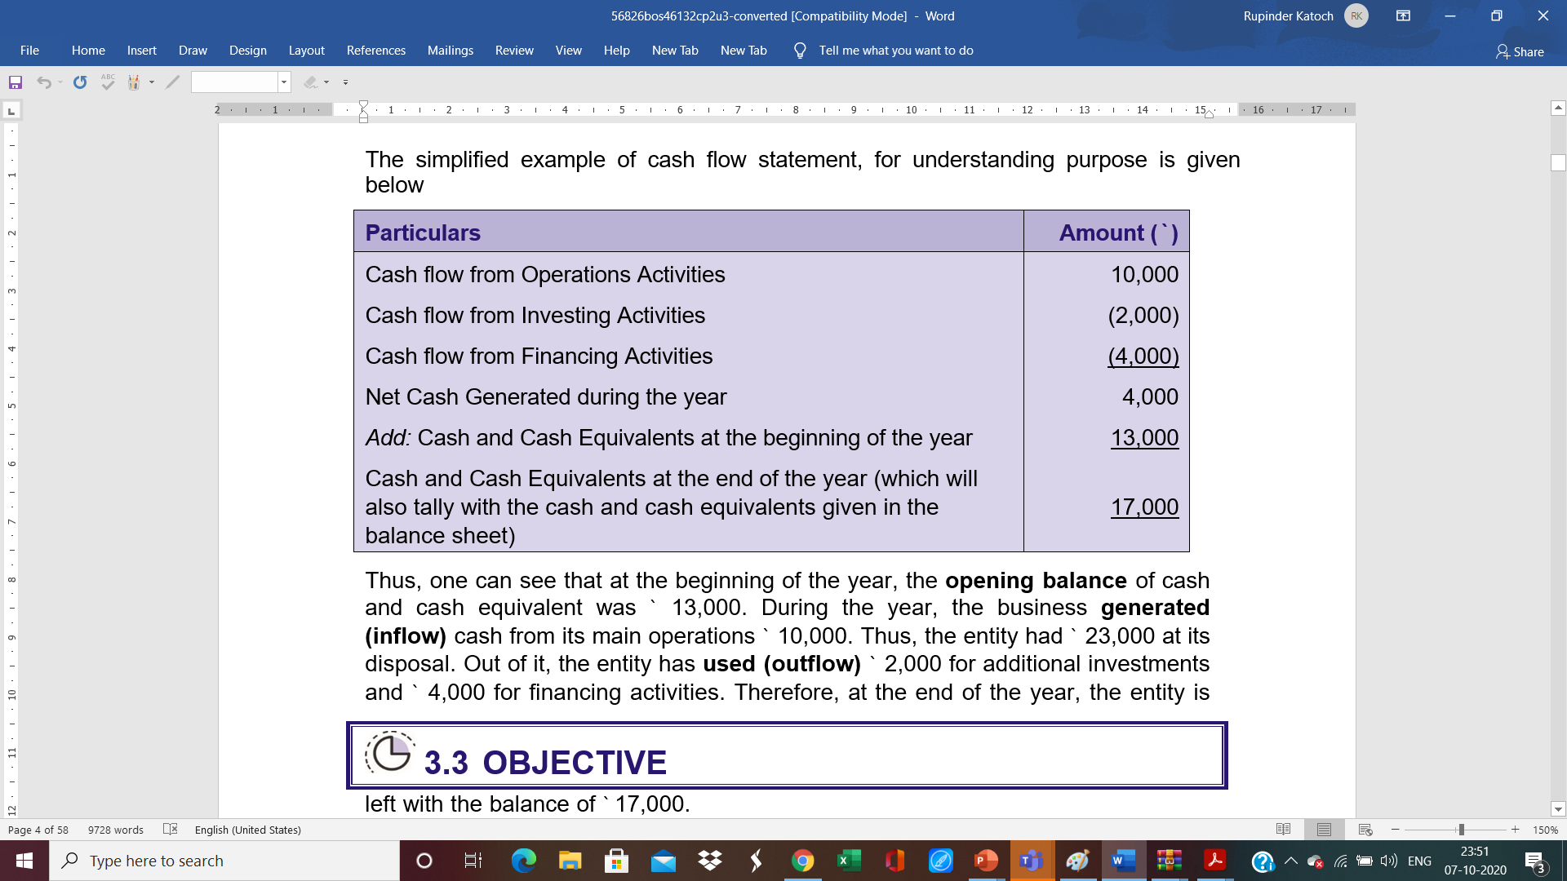

Slide 23
How to read Cash Flow Statement? Case Analysis of IronMount & Bronze Metal
Which company is displaying elements of cash flow stress?
IronMount Corp and BronzeMetal Corp had identical cash positions at the beginning and end of 2007.
Each company also reported a net income of $225,000 for 2007.
IronMount and Bronze Metal, both companies have the same end of the year cash of $365,900.
Additionally, changes in cash during the year is the same at $315,900.

Slide 24
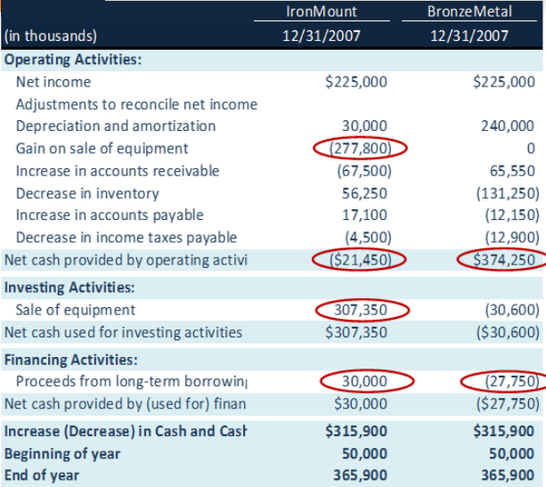
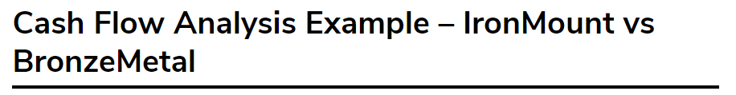

Slide 25
We note that Cash Flow from Operations is negative for IronMount at
-21,450. Gain on sale of equipment is deducted as this is not an operating cash flow. IronMount sale of equipment adds 307,350 which contributes to the increase in the cash.
On the other hand, when we look at BronzeMetal, we note that its cash flow from operations are strong at $374,250 and seems to be doing great in its business. They are not relying on the one-time sale of equipment to generate cash flows.
With this, we conclude that IronMount is showing signs of stress due to low core operating income and its reliance on other one-time items to generate cash.

Slide 26
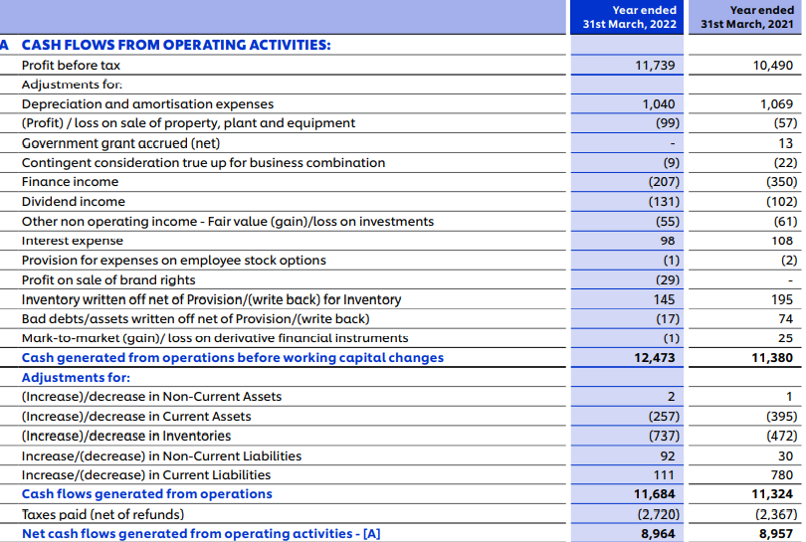
Analysis of HUL’s Cash Flow statement
Notes:
In adjustments- A- Increase/decrease of Non CA in HUL balance sheet is Long term loan and advances i.e. given to employees, directors. So it is operating activity.
B. Increase/decrease of Non CL in HUL balance sheet is Long term provisions i.e. related to statutory dues, post retirement benefits. So it is considered as operating activity.

Slide 27
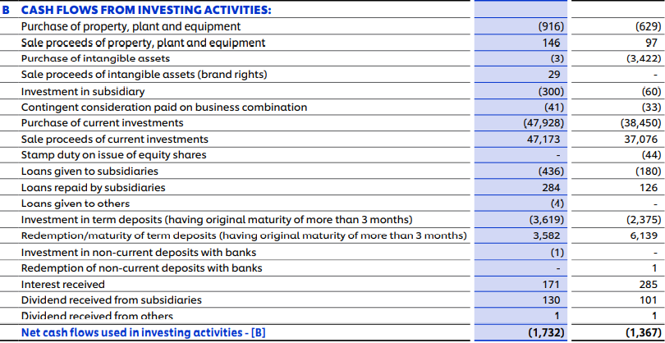
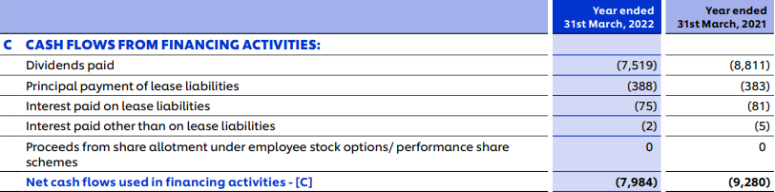

Slide 28
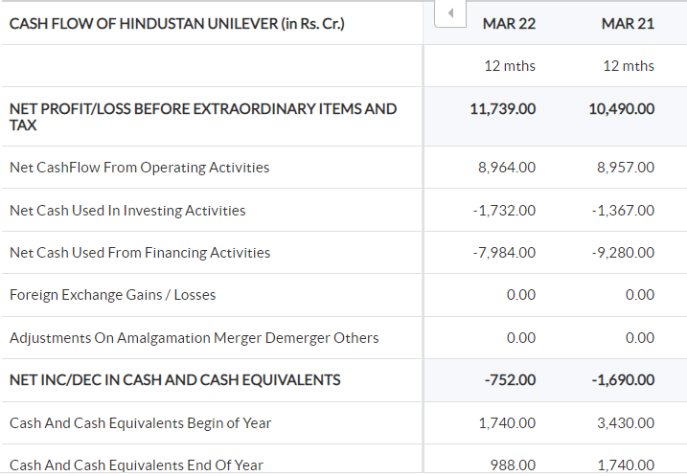

Slide 29
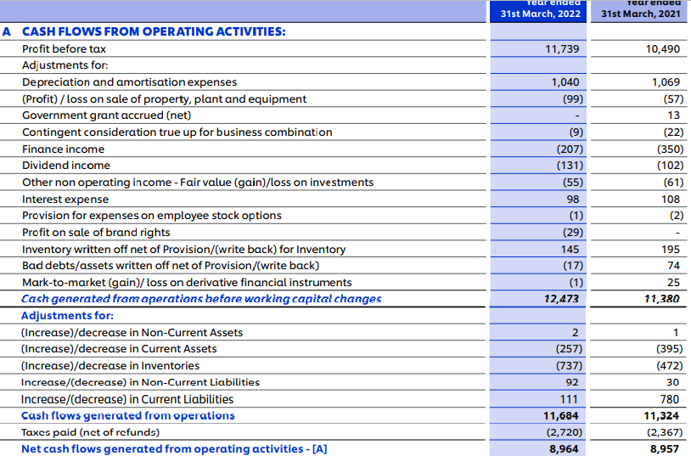
Analysis of Operating Activities

Slide 30
Analysis of Operating Activities: 2021-22
HUL is cash rich company. Operating cash flows of the company are characterized by rationalization of its working capital.
Out of ‘cash flows before working capital changes’ of ` 12473 Cr., it has utilized a net sum of ` 789 Cr. (-257- 737 + 2 + 92 +111) in reducing its current liabilities , it has still having generated cash from operations upto 11684 Cr.
Finally after paying income tax it has generated a net cash of ` 8964 Cr. This net cash generation is commendable as it has applied cash in reducing the current liabilities.
The company’s current ratio is 1.3: 1, quite satisfactory and which will enable it get working capital and term loan facilities when needed.
Notes:
In adjustments- A- Increase/decrease of Non CA ( 2Cr) in HUL balance sheet is Long term loan and advances i.e. given to employees, directors. So it is operating activity.
B. Increase/decrease of Non CL (92 Cr) in HUL balance sheet is Long term provisions i.e. related to statutory dues, post retirement benefits. So it is considered as operating activity.

Slide 31
Analysis of Investing Activities

Slide 32
Analysis of Investing Activities: 2021-22
Cash outflow from investing activities is mainly due to purchase of income generating PPE by 916 Cr. (Capital work in progress) and it will strengthen the future operational cash inflows of the company.
Furthermore, the company has done current investment by 47928 Cr. and other investments in subsidiary and term deposits etc.
Cash inflow from investing activities is due to sale of current investment by 47173 Cr, sale of PPE by 146 Cr. and redemption/maturity of term deposits and receipt of interest/dividend.
Therefore on overall basis, out of ` 8964 Cr’ generated from operational cash inflow, ` 1732 Cr, has been utilized towards investing activities.

Slide 33
Analysis of Financing Activities

Slide 34
Analysis of Financing Activities & overall basis: 2021-22
The remaining amount from operating activity (894-1732= 7232 Cr) and beginning cash balance (752 Cr) been used for repayment of dividend (7519 Cr), payment of lease liability (388 Cr), interest paid (75 Cr) etc.
Overall- Net operational cash inflows (8964 Cr) are used for meeting investing (1732 Cr) as well as financing (7984 Cr) activity outflows. The primary source of cash for HUL is operating activities and it indicates an efficient management of working capital.
Thus after meeting all the activities, HUL has still sound cash position with closing balance of 988 Cr. It has been generating cash from operating activities, utilizing this money in expanding its business, making investments and payment of long term liabilities i.e. dividend, interest etc..
Future outlook indicates towards higher cash inflows from operations and better borrowing capacity.

Slide 35
REVIEW QUESTIONS(TRUE/FALSE)
(i) Cash from business operations can be determined from income statement.
(ii) Working capital from business operations can be determined from profit and loss account.
(iii) Sources of cash should always be more than uses of cash, in the context of cash flows statement.
(iv) Interest paid on debentures is a part of operating activities.
(v) Interest received on two-months deposits in bank is shown under investing activities.
(vi) Sources of cash and uses of cash are to be equal.
Notes:
[Answers: (i) False, (ii) True, (iii) False, (iv) False, (v) False, (vi) False, (vii) True,
(viii) False, (ix) False, (x) False, and (xi) True.]

Slide 36
(vii) Cash flows are inflows and outflows of cash and cash-equivalents.
(viii) Revaluation of building affects cashflows.
(ix) Sale proceeds from machinery, being a source of finance, form part of financing activities.
(x) Cash flow statement is mandatory for all business firms.
(xi) In normal circumstances a firm has positive cash from operations and negative cash flow frominvesting activities.
Notes:
[Answers: (i) False, (ii) True, (iii) False, (iv) False, (v) False, (vi) False, (vii) True,
(viii) False, (ix) False, (x) False, and (xi) True.]

Slide 37
Pick the right option
(i)Cash flow statement (based on AS-3) indicates change in (cash/bank/cash and cash-equivalents).
(ii) Decrease in creditors (Decreases/Increases) cash.
(iii) Interest received on long-term investments is shown under (Operating/Financing/Investing activities).
(iv) Decrease in inventory (Decreases/Increases) cash.
(v) Increase in pre-paid expenses (Decreases/Increases) cash.

Slide 38
(vi) Cash payments to suppliers for goods and services are shown under (Operating/Financing/Investing activities).
(vii) Cash-flow statement of listed companies should be presented as per the(Indirect/Direct) method.
(viii) Cash payments to acquire long-term assets form part of (Financing/Investing activities).
(ix) Buy back of shares is shown under (Financing/Investing activities).
(x) Dividends paid to shareholders are classified as (Financing/Investing activities).

Slide 39
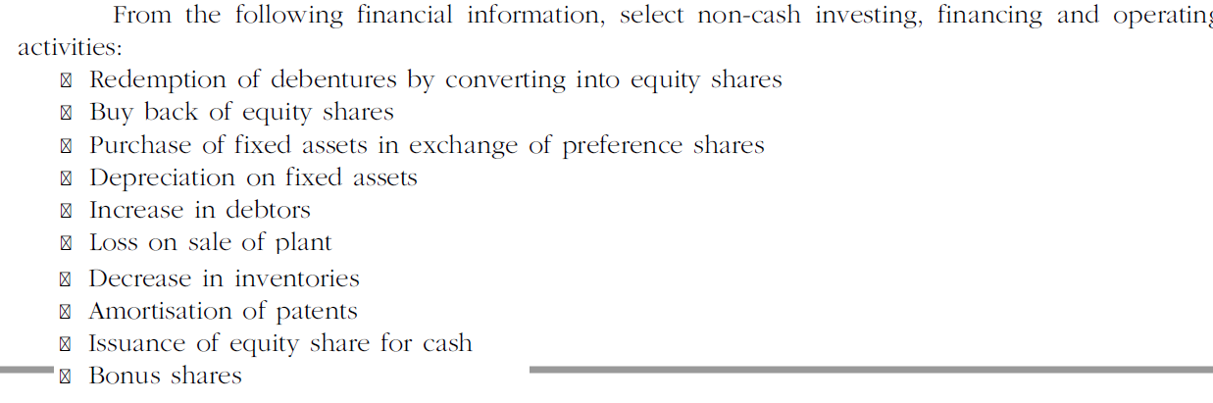
Pick the right options
Notes:
Answer: (Non-cash activities)
Investing: Purchase of fixed assets in exchange of preference shares.
Financing: (i) Redemption of debentures by converting into equity shares,
(ii) Issue of preference shares for purchase of fixed assets,
(iii) Bonus shares
Operating: (i) Depreciation on fixed
assets, (ii) Amortisation of patents, (iii) Loss on sale of plant.]

Slide 40
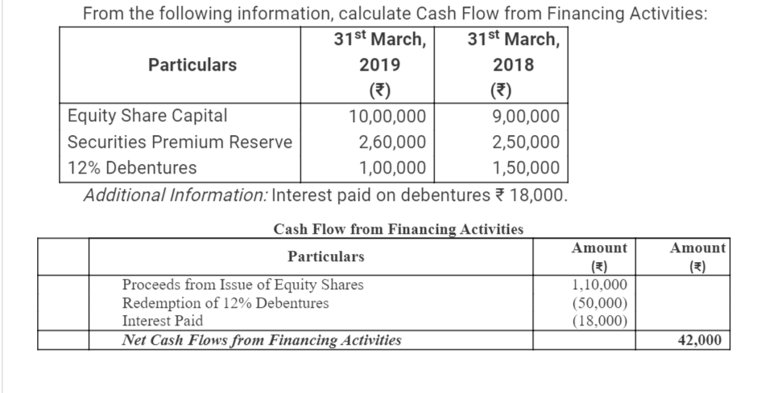
Financing Activity

